Slide 1




Foundations of Data Analytics
Module 01
Over 2.5 quintillion bytes of data are created every single day, equivalent to streaming over 250 million hours of HD video on YouTube. Data Analytics helps make sense of this massive flood of information, turning it into actionable insights!

Slide 2


Class Objectives
1
Understand central tendency measures (mean, median, mode) and their implications
2
Calculate and interpret measures of dispersion (range, variance, standard deviation)
3
Understand the bell-shaped curve of the normal distribution
4
Analyze frequency distributions using bar charts, histograms, and boxplots

Slide 3

Unlocking the Power of Data Real-World Use Cases

Slide 4

Uses viewing history, ratings, and behavior patterns to recommend content
Analyzes user data to make decisions about new show productions
Famous example: Decision to produce "House of Cards" was based on data showing viewers liked political dramas, and the original British version
Reference: Netflix Technology Blog, Netflix Recommendations: Beyond the 5 stars

Slide 5

Uses data analytics to predict product demand
Analyzes weather forecasts to stock appropriate items
Famous example: Increased Pop-Tart sales before hurricanes
Reference: Food Logistics, Walmart Uses Weather Forecasts To Predict Sales

Slide 6

Uses machine learning models to detect fraudulent transactions
Analyzes millions of transactions in real-time
Saved an estimated $2 billion in potential fraud
Reference: American Express Machine Learning Conference presentations

Slide 7

Famous case of predicting customer pregnancy based on purchase patterns
Created pregnancy prediction scores for marketing purposes
Led to improved targeted marketing campaigns
Reference: New York Times, How Companies Learn Your Secrets

Slide 8
Types of Data Analytics
How can we make it happen?
Prescriptive
Analytics
What will happen?
Predictive
Analytics
Why did it happen?
Diagnostic
Analytics
Foresight
What happened?
Descriptive
Analytics
Hindsight

Slide 9




Data Types
Qualitative (Categorical)
Quantitative (Numerical)

Slide 10
Data Types
Qualitative (Categorical)
Quantitative (Numerical)
Ordinal
(ordered)
Nominal
(not ordered)
Continuous
(can be divided)
Discreet
(can’t be divided)

Slide 11
Data Types
Qualitative (Categorical)
Quantitative (Numerical)
Ordinal
(ordered)
Nominal
(not ordered)
Continuous
(can be divided)
Discreet
(can’t be divided)
Customer satisfaction scores
Rating scale from 1 to 5
Education Levels
High School, Bachelor’s,
Master's, Ph.D.
Gender
Zip Code
Eye Color
Height
Time
Temperature
Number of employees
Number of children in a family
Number of items in inventory

Slide 12

Guided Demo
Real-World Use Cases

Slide 13
Coffee Shop Data
Data Types

Slide 14
Data Types
Customer_ID | Drink_Size | Temperature | Payment_Method | Rating | Time_of_Day | Loyalty_Points | Is_Regular
001 | Large | Hot | Credit Card | 4 | Morning | 150 | Y
002 | Medium | Cold | Cash | 5 | Afternoon | 75 | N
003 | Small | Hot | Mobile Pay | 3 | Evening | 200 | Y
004 | Large | Iced | Credit Card | 5 | Morning | 300 | Y
005 | Medium | Hot | Cash | 4 | Evening | 0 | N

Slide 15
Data Types
Customer_ID | Drink_Size | Temperature | Payment_Method | Rating | Time_of_Day | Loyalty_Points | Is_Regular
001 | Large | Hot | Credit Card | 4 | Morning | 150 | Y
002 | Medium | Cold | Cash | 5 | Afternoon | 75 | N
003 | Small | Hot | Mobile Pay | 3 | Evening | 200 | Y
004 | Large | Iced | Credit Card | 5 | Morning | 300 | Y
005 | Medium | Hot | Cash | 4 | Evening | 0 | N

Slide 16
Data Types
Customer_ID | Drink_Size | Temperature | Payment_Method | Rating | Time_of_Day | Loyalty_Points | Is_Regular
001 | Large | Hot | Credit Card | 4 | Morning | 150 | Y
002 | Medium | Cold | Cash | 5 | Afternoon | 75 | N
003 | Small | Hot | Mobile Pay | 3 | Evening | 200 | Y
004 | Large | Iced | Credit Card | 5 | Morning | 300 | Y
005 | Medium | Hot | Cash | 4 | Evening | 0 | N
Qualitative
nominal

Slide 17
Data Types
Customer_ID | Drink_Size | Temperature | Payment_Method | Rating | Time_of_Day | Loyalty_Points | Is_Regular
001 | Large | Hot | Credit Card | 4 | Morning | 150 | Y
002 | Medium | Cold | Cash | 5 | Afternoon | 75 | N
003 | Small | Hot | Mobile Pay | 3 | Evening | 200 | Y
004 | Large | Iced | Credit Card | 5 | Morning | 300 | Y
005 | Medium | Hot | Cash | 4 | Evening | 0 | N
Qualitative
nominal
Qualitative
ordinal

Slide 18
Data Types
Customer_ID | Drink_Size | Temperature | Payment_Method | Rating | Time_of_Day | Loyalty_Points | Is_Regular
001 | Large | Hot | Credit Card | 4 | Morning | 150 | Y
002 | Medium | Cold | Cash | 5 | Afternoon | 75 | N
003 | Small | Hot | Mobile Pay | 3 | Evening | 200 | Y
004 | Large | Iced | Credit Card | 5 | Morning | 300 | Y
005 | Medium | Hot | Cash | 4 | Evening | 0 | N
Qualitative
nominal
Qualitative
ordinal
Qualitative
nominal

Slide 19
Data Types
Customer_ID | Drink_Size | Temperature | Payment_Method | Rating | Time_of_Day | Loyalty_Points | Is_Regular
001 | Large | Hot | Credit Card | 4 | Morning | 150 | Y
002 | Medium | Cold | Cash | 5 | Afternoon | 75 | N
003 | Small | Hot | Mobile Pay | 3 | Evening | 200 | Y
004 | Large | Iced | Credit Card | 5 | Morning | 300 | Y
005 | Medium | Hot | Cash | 4 | Evening | 0 | N
Qualitative
nominal
Qualitative
ordinal
Qualitative
nominal
Qualitative
nominal

Slide 20
Data Types
Customer_ID | Drink_Size | Temperature | Payment_Method | Rating | Time_of_Day | Loyalty_Points | Is_Regular
001 | Large | Hot | Credit Card | 4 | Morning | 150 | Y
002 | Medium | Cold | Cash | 5 | Afternoon | 75 | N
003 | Small | Hot | Mobile Pay | 3 | Evening | 200 | Y
004 | Large | Iced | Credit Card | 5 | Morning | 300 | Y
005 | Medium | Hot | Cash | 4 | Evening | 0 | N
Qualitative
nominal
Qualitative
ordinal
Qualitative
nominal
Qualitative
nominal
Qualitative
ordinal

Slide 21
Data Types
Customer_ID | Drink_Size | Temperature | Payment_Method | Rating | Time_of_Day | Loyalty_Points | Is_Regular
001 | Large | Hot | Credit Card | 4 | Morning | 150 | Y
002 | Medium | Cold | Cash | 5 | Afternoon | 75 | N
003 | Small | Hot | Mobile Pay | 3 | Evening | 200 | Y
004 | Large | Iced | Credit Card | 5 | Morning | 300 | Y
005 | Medium | Hot | Cash | 4 | Evening | 0 | N
Qualitative
nominal
Qualitative
ordinal
Qualitative
nominal
Qualitative
nominal
Qualitative
ordinal
Qualitative
ordinal

Slide 22
Data Types
Customer_ID | Drink_Size | Temperature | Payment_Method | Rating | Time_of_Day | Loyalty_Points | Is_Regular
001 | Large | Hot | Credit Card | 4 | Morning | 150 | Y
002 | Medium | Cold | Cash | 5 | Afternoon | 75 | N
003 | Small | Hot | Mobile Pay | 3 | Evening | 200 | Y
004 | Large | Iced | Credit Card | 5 | Morning | 300 | Y
005 | Medium | Hot | Cash | 4 | Evening | 0 | N
Qualitative
nominal
Qualitative
ordinal
Qualitative
nominal
Qualitative
nominal
Qualitative
ordinal
Qualitative
ordinal
Quantitative
discreet

Slide 23
Data Types
Customer_ID | Drink_Size | Temperature | Payment_Method | Rating | Time_of_Day | Loyalty_Points | Is_Regular
001 | Large | Hot | Credit Card | 4 | Morning | 150 | Y
002 | Medium | Cold | Cash | 5 | Afternoon | 75 | N
003 | Small | Hot | Mobile Pay | 3 | Evening | 200 | Y
004 | Large | Iced | Credit Card | 5 | Morning | 300 | Y
005 | Medium | Hot | Cash | 4 | Evening | 0 | N
Qualitative
nominal
Qualitative
ordinal
Qualitative
nominal
Qualitative
nominal
Qualitative
ordinal
Qualitative
ordinal
Quantitative
discreet
Qualitative
nominal

Slide 24
Students Grades
Measures of Central Tendency

Slide 25
Data Types
Student | Math | Science | English | Study_Hours
Ali | 85 | 92 | 78 | 3.5
Bob | 90 | 88 | 95 | 4.0
Camila | 78 | 75 | 82 | 2.5
David | 90 | 85 | 88 | 3.0
Eiko | 95 | 90 | 85 | 4.5

Slide 26
Data Types
Student | Math | Science | English | Study_Hours
Ali | 85 | 92 | 78 | 3.5
Bob | 90 | 88 | 95 | 4.0
Camila | 78 | 75 | 82 | 2.5
David | 90 | 85 | 88 | 3.0
Eiko | 95 | 90 | 85 | 4.5
Qualitative
nominal
Quantitative
discreet
Quantitative
discreet
Quantitative
discreet
Quantitative
Continuous

Slide 27

Mean
Math
85
90
78
90
95

Slide 28
Mean
Math
85
90
78
90
95

Slide 29
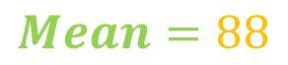
Median
Math
85
90
78
90
95
Math
85
78
90
90
95
Order data

Slide 30
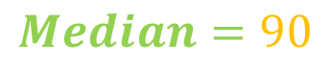
Median
Math
85
92
78
90
95
Math
85
78
90
90
95
Order data

Slide 31

Mode
Math
85
92
78
90
95
Math
90 | 2
78 | 1
85 | 1
95 | 1
Calculate
frequency

Slide 32
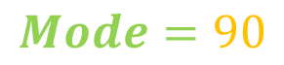
Mode
Math
85
92
78
90
95
Math
90 | 2
78 | 1
85 | 1
95 | 1
Calculate
frequency

Slide 33
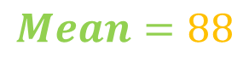
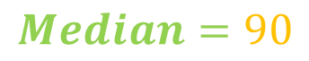
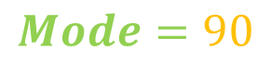
Mode
Math
85
92
78
90
95

Slide 34

Mode
Math
85
92
78
90
95
middle
most frequent
average

Slide 35
Employees Performance
Measures of Dispersion

Slide 36

Measures of Dispersion

Slide 37
Measures of Dispersion

Slide 38
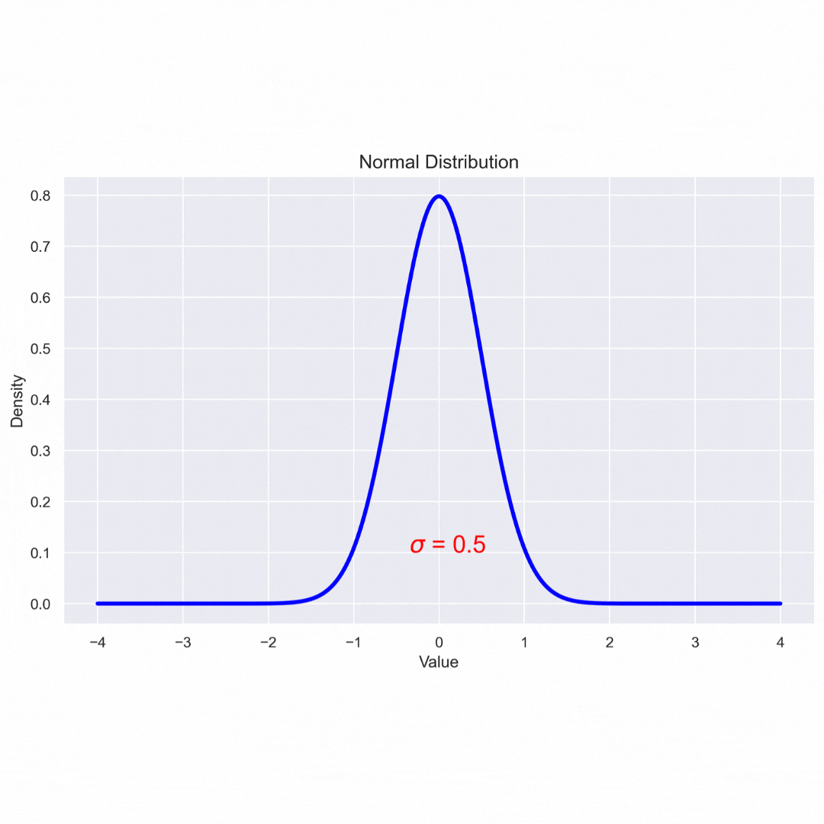
Data Distribution

Slide 39
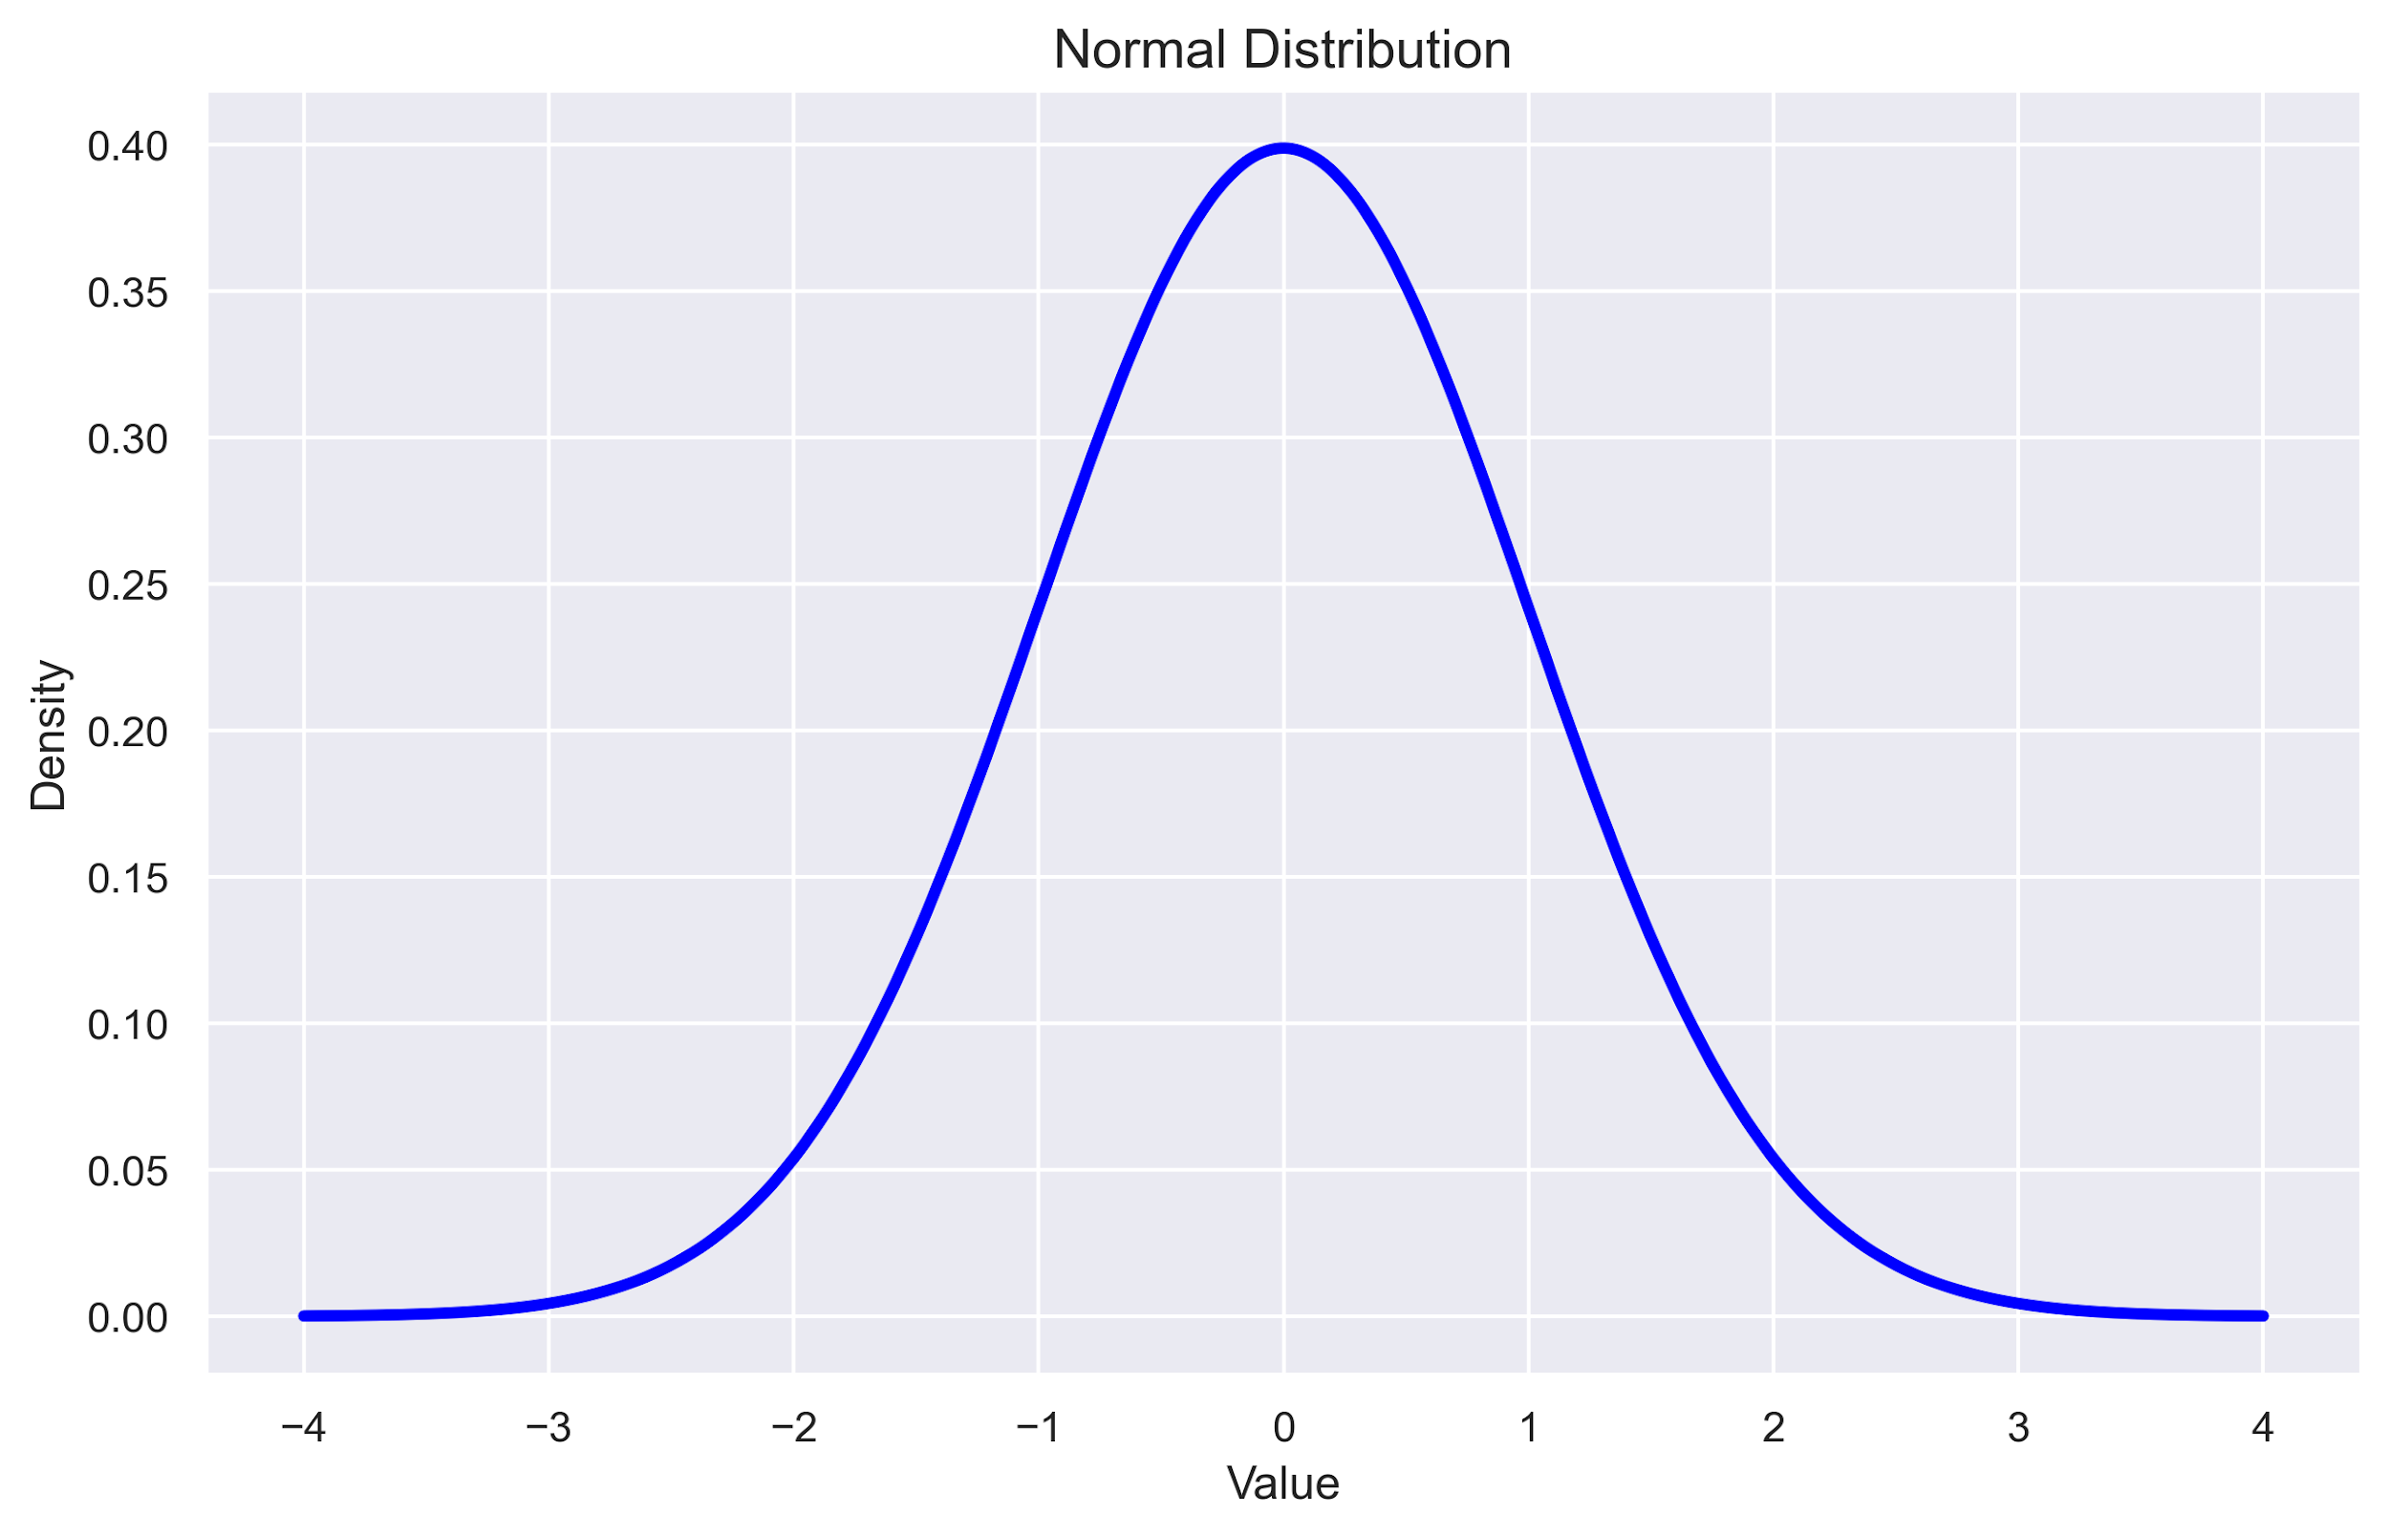
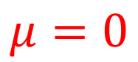
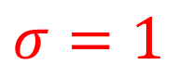
Data Distribution

Slide 40
Data Distribution
In a normal distribution:
68% of data points fall within 1 standard deviation of the mean
95% fall within 2 standard deviations
99.7% fall within 3 standard deviations

Slide 41
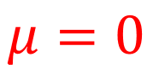
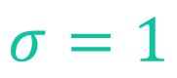
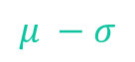
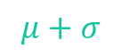

Data Distribution

Slide 42
Data Distribution
68% of Data

Slide 43
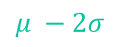
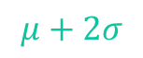
Data Distribution
95% of Data

Slide 44
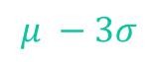
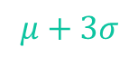
Data Distribution
99.7% of Data

Slide 45
Measures of Dispersion
A dataset of employee performance containing sales amount, salary, and customer feedback, with a total of 1,000 rows
Employee_ID | Sales_Amount (USD) | Employee_Salary (USD) | Customer_Feedback_Score
E1 | 51118 | 24952 | 3.7
E2 | 53829 | 23420 | 4.2
E3 | 48554 | 10474 | 4.5
E4 | 57198 | 10000 | 4.1
E5 | 40668 | 29857 | 4.6
first five
rows

Slide 46
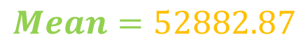
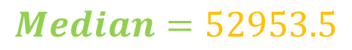
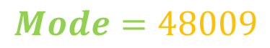
Central Tendency
Sales_Amount (USD)
51118
53829
48554
57198
40668

Slide 47
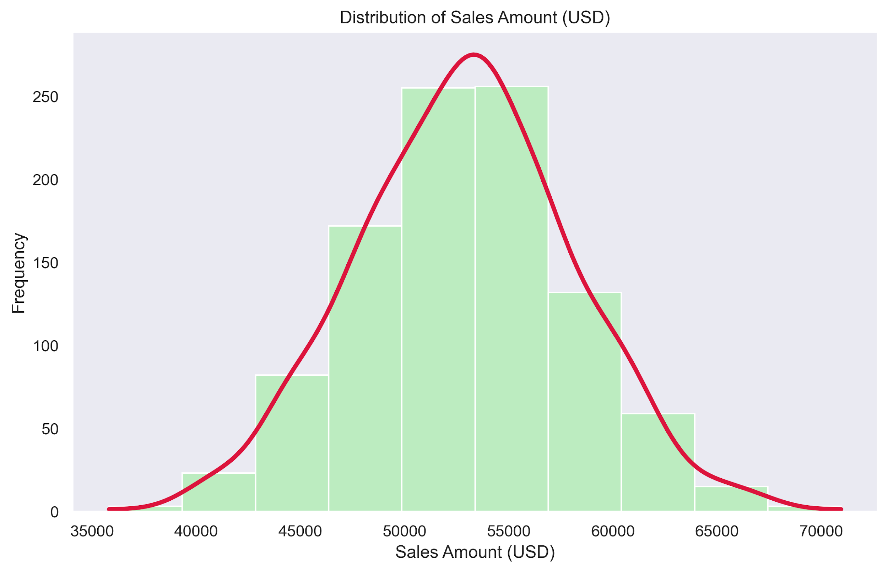
Data Distribution
Sales_Amount (USD)
51118
53829
48554
57198
40668

Slide 48
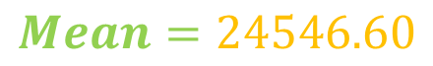
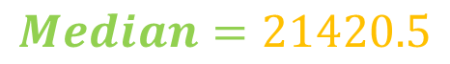
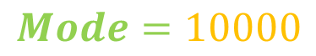
Central Tendency
Employee_Salary (USD)
24952
23420
10474
10000
29857

Slide 49
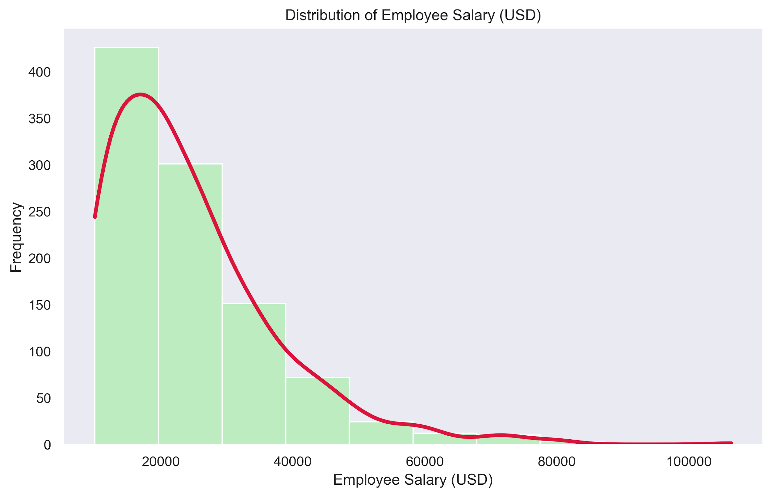
Data Distribution
Employee_Salary (USD)
24952
23420
10474
10000
29857

Slide 50
Visual Clues
Interpreting Data Through the Power of Charts

Slide 51
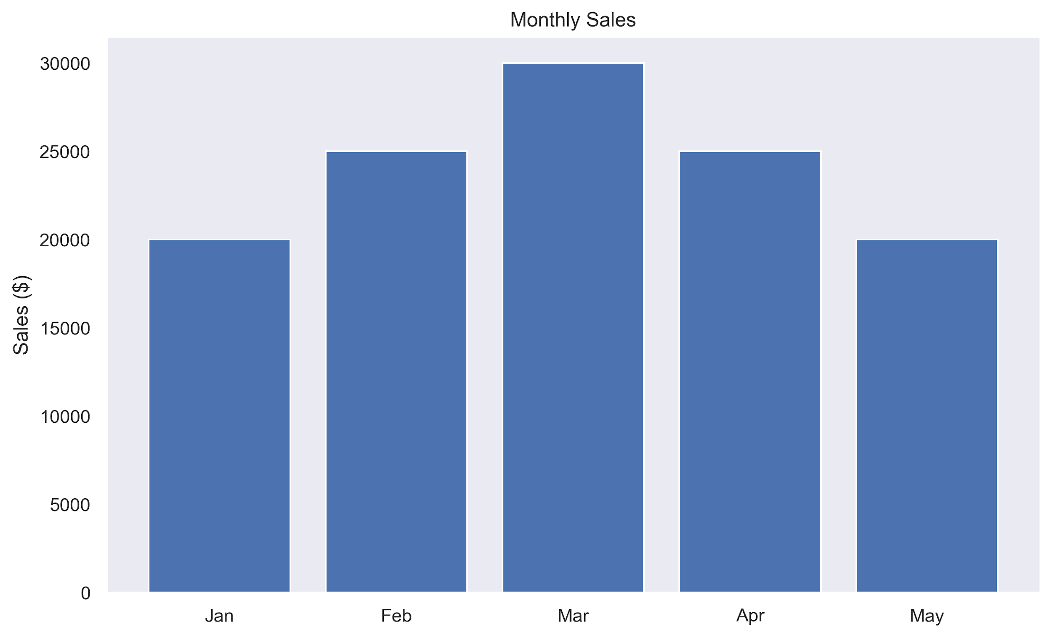
Bookstore Sales

Slide 52
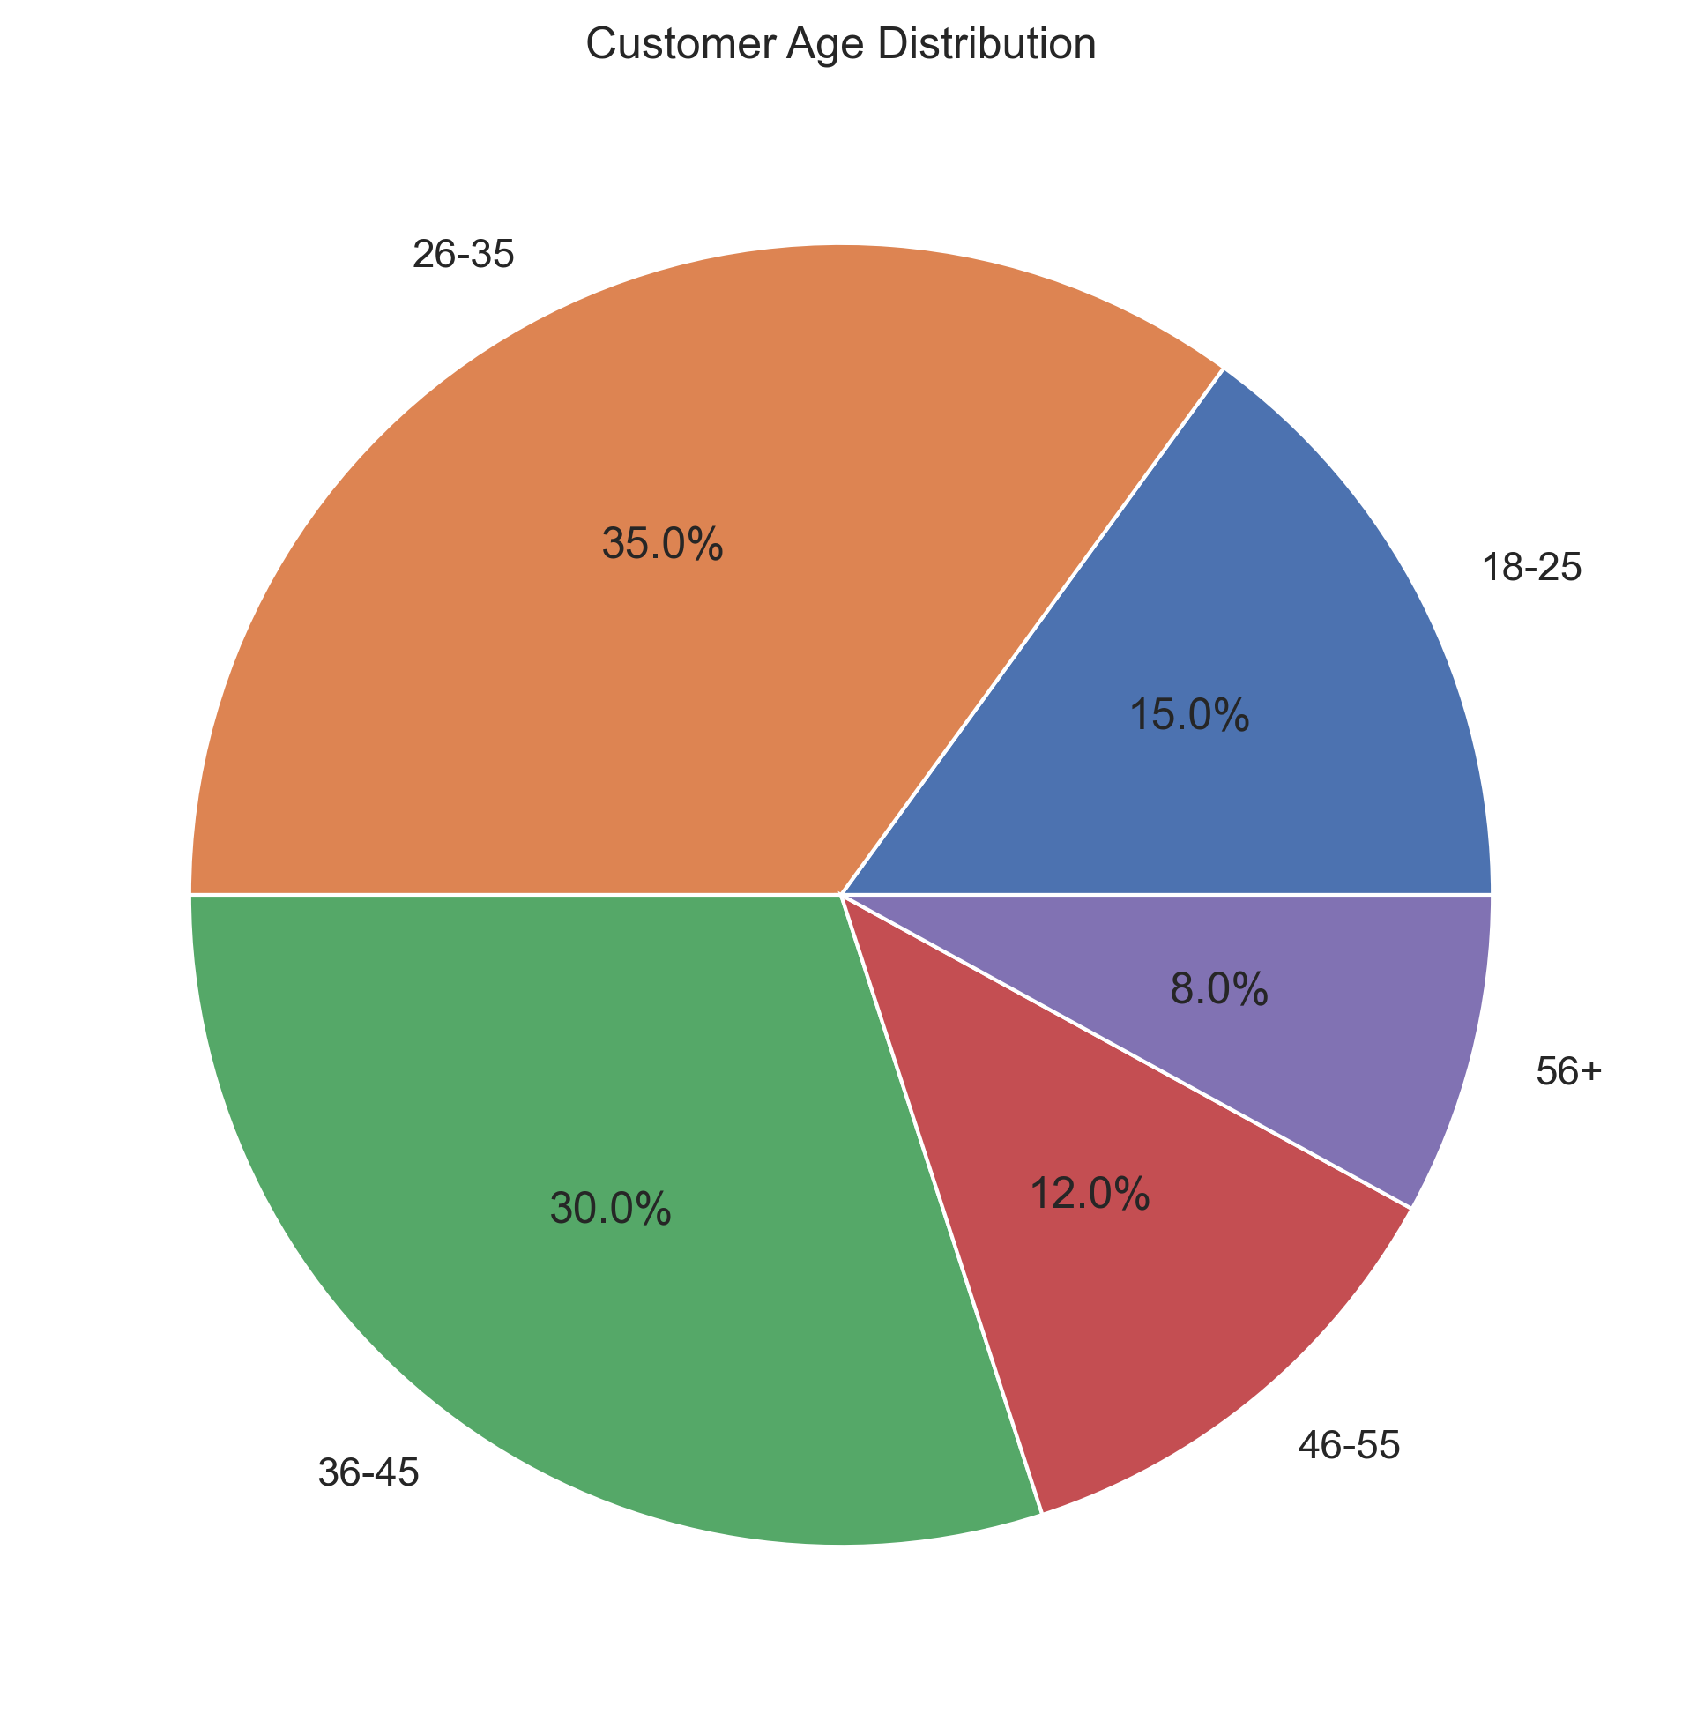
Customer Age Distribution

Slide 53
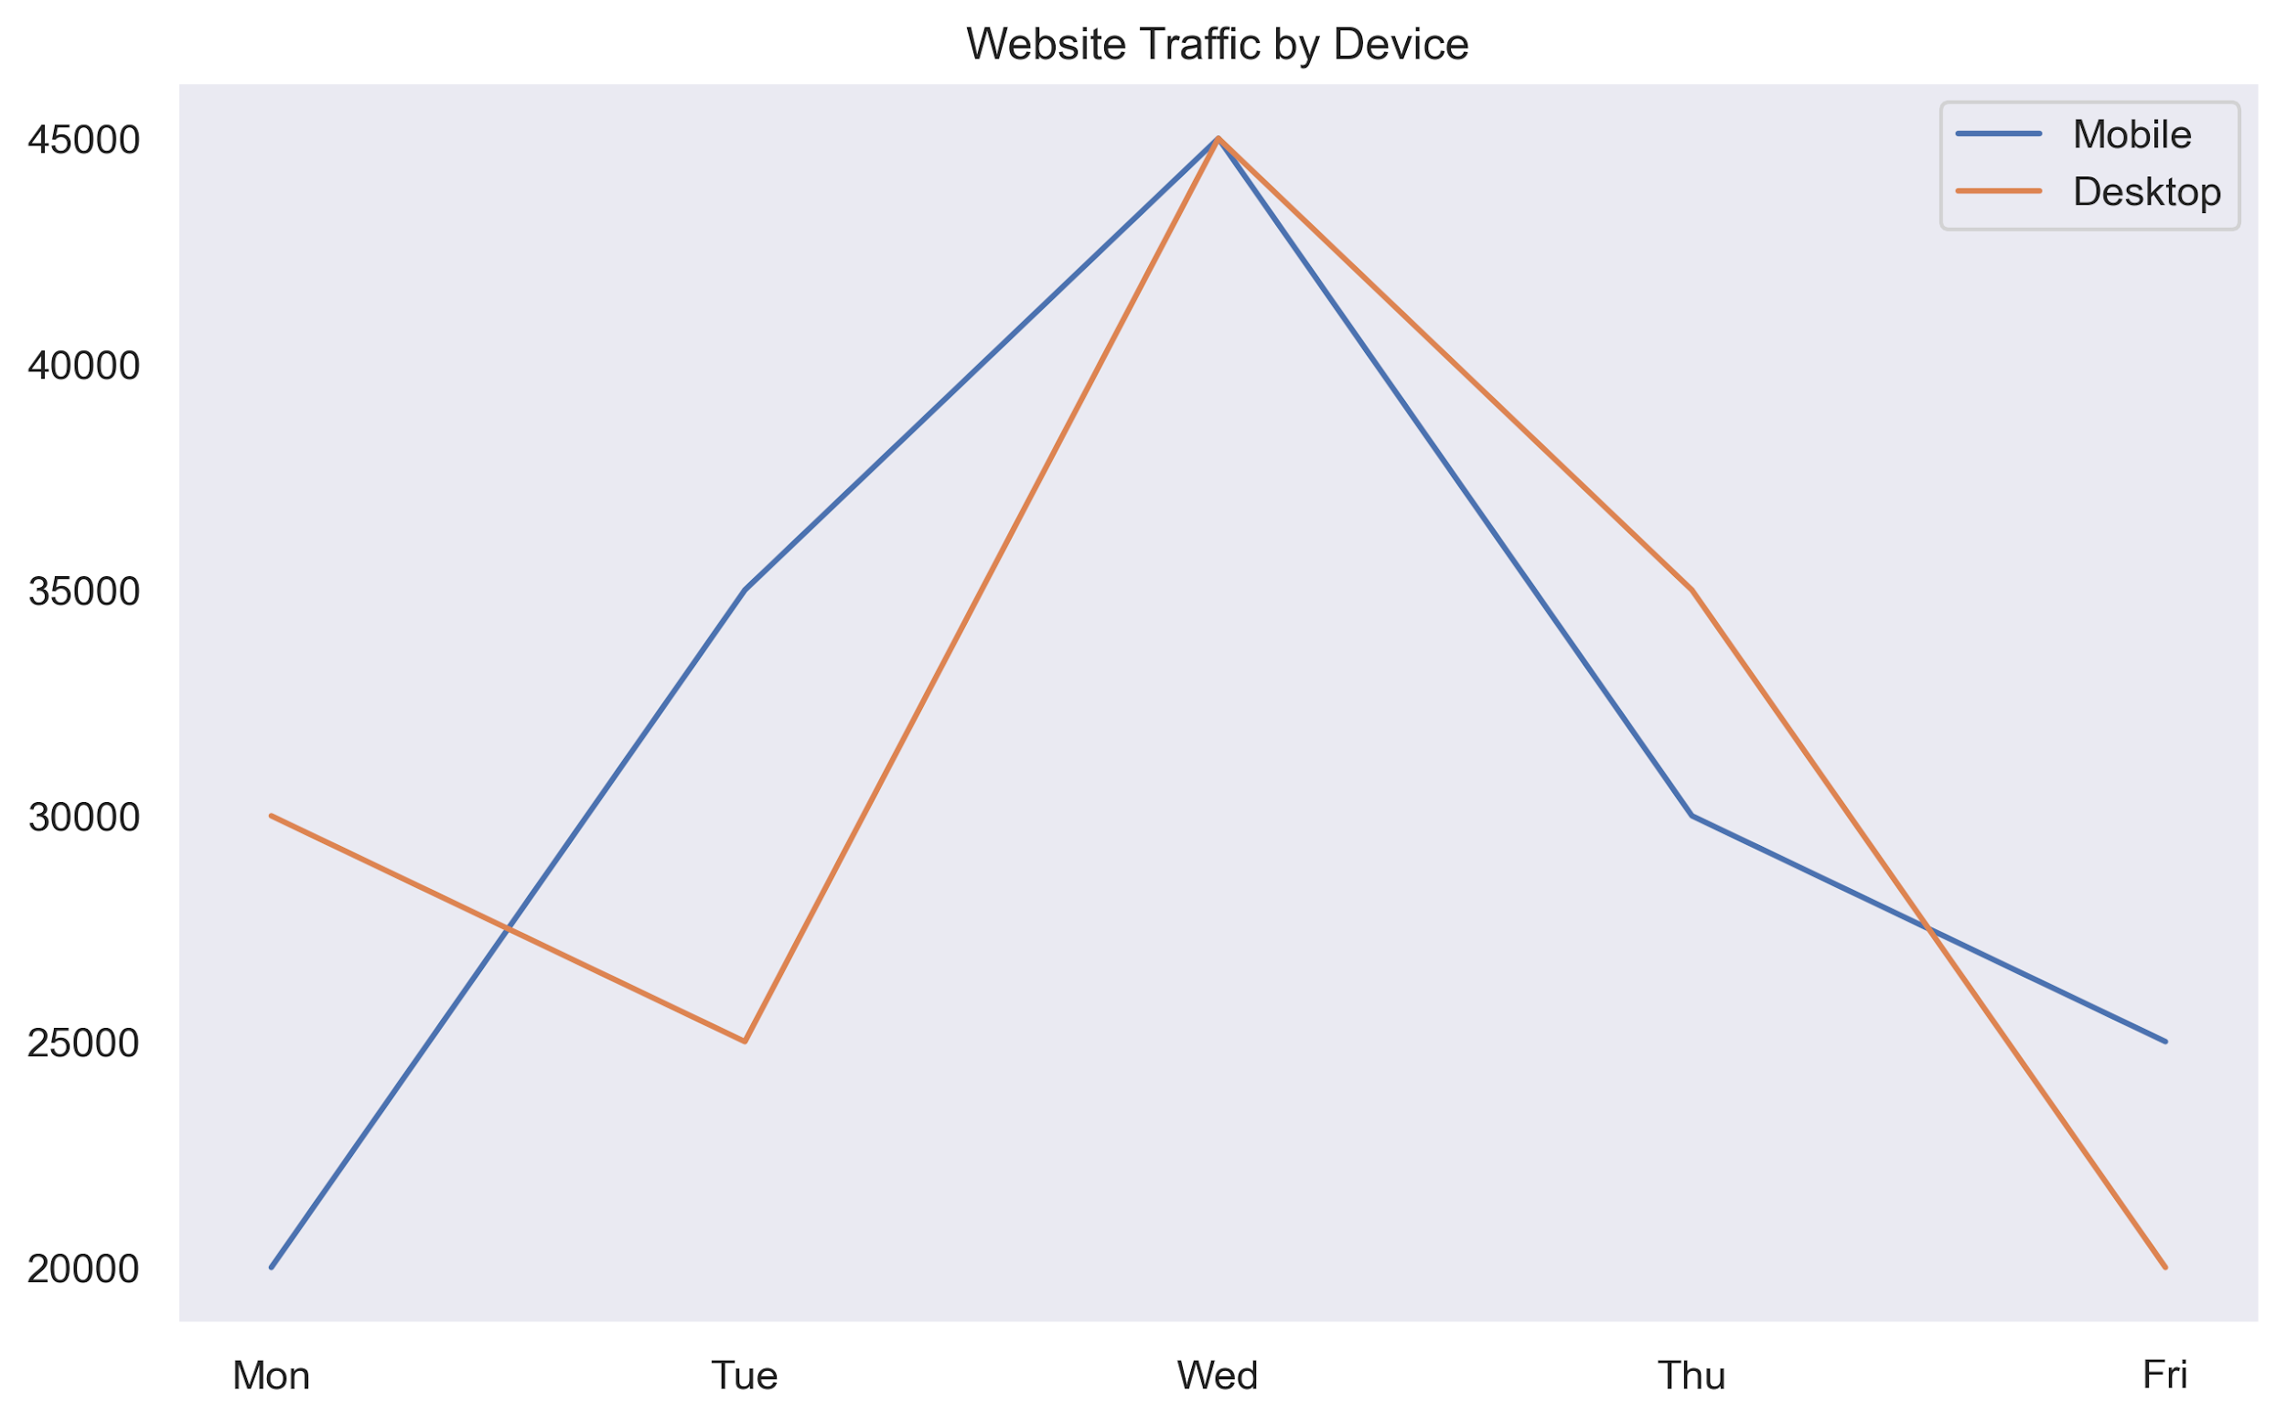
Website Traffic

Slide 54
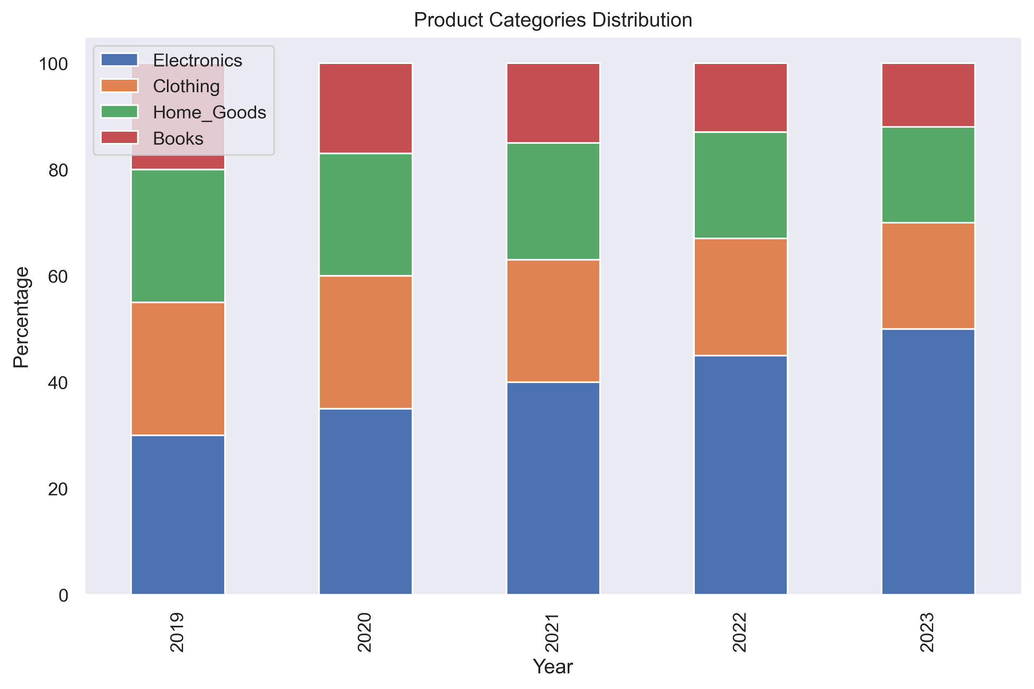
Revenue Shares By Product

Slide 55
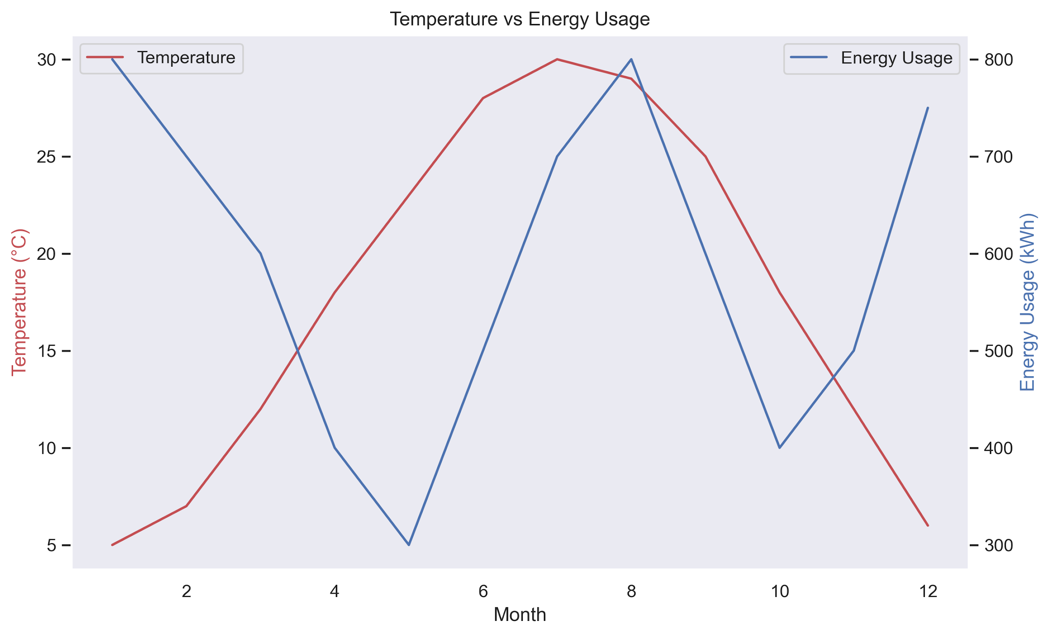
Temperature vs. Energy Consumption

Slide 56
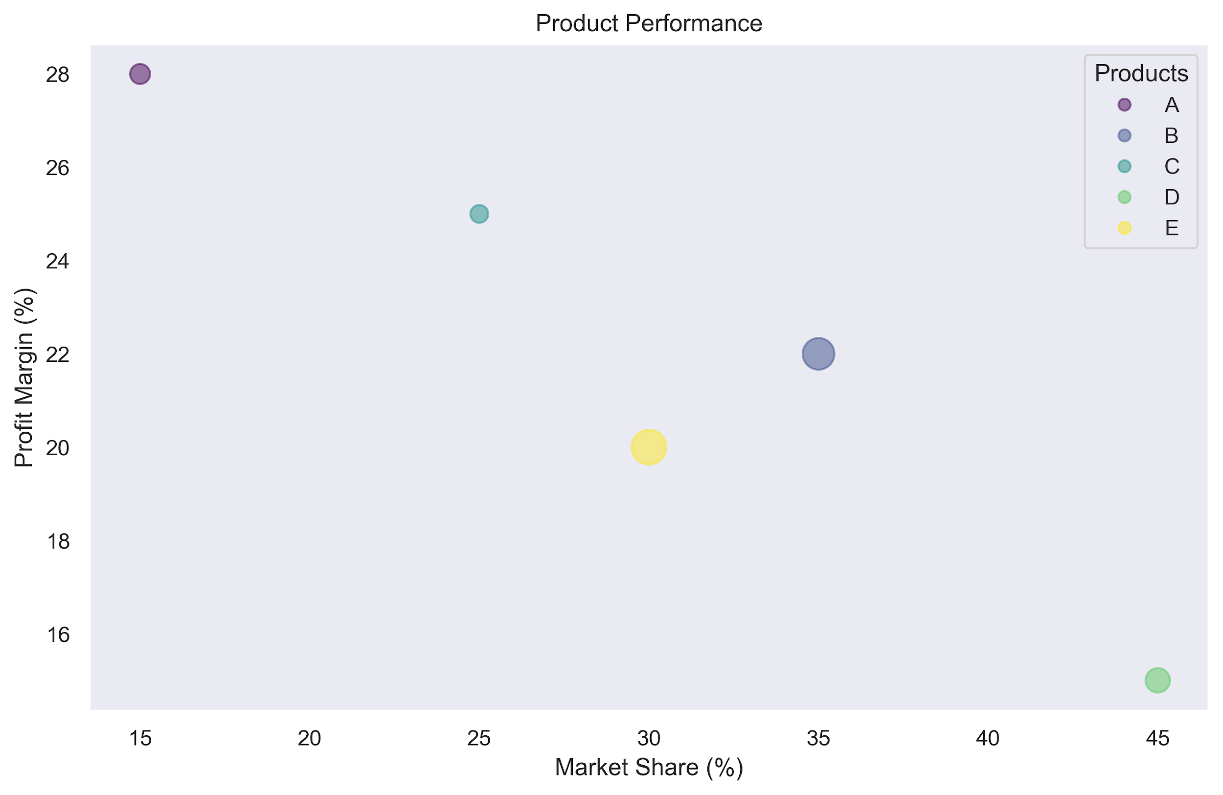
Product Performance
Bubble size represent Revenue

Slide 57
Challenge
Data Detectives
Uncovering Types, Trends, and Insights

Slide 58
Challenge: Data Detectives
FitTech, a modern fitness center, has provided a sample dataset of 10 members. Here's the dataset:
Member ID | Age | Monthly Fee ($) | Visits per Month | Profession | Membership Type | Join Date | Uses App | Has Personal Trainer | Meeting Goals
1 | 24 | 45 | 12 | Student | Basic | 2023-01-15 | Yes | No | TRUE
2 | 38 | 85 | 20 | Manager | Premium | 2023-01-20 | Yes | Yes | TRUE
3 | 45 | 65 | 8 | Teacher | Basic | 2023-01-10 | No | No | FALSE
4 | 29 | 85 | 15 | Nurse | Premium | 2023-01-25 | Yes | Yes | TRUE
5 | 52 | 45 | 4 | Doctor | Basic | 2023-01-12 | No | No | FALSE
6 | 33 | 85 | 16 | Engineer | Premium | 2023-01-18 | Yes | Yes | TRUE
7 | 28 | 65 | 10 | Designer | Basic | 2023-01-22 | Yes | No | FALSE
8 | 41 | 85 | 18 | Lawyer | Premium | 2023-01-28 | Yes | Yes | TRUE
9 | 35 | 45 | 6 | Writer | Basic | 2023-01-14 | No | No | FALSE
10 | 47 | 85 | 22 | Consultant | Premium | 2023-01-30 | Yes | Yes | TRUE
Get this challenge’s files from Module 01 Live Lesson Challenge in Google Classroom

Slide 59
Challenge: Data Detectives
In this challenge you will:
Variable Analysis
Identify the types of variables in the dataset
Basic Calculations
Calculate the mean for monthly fee
Find the median number of visits per month
Data Interpretation
What relationship do you observe between membership type and meeting goals?
Is there any apparent correlation between monthly visits and meeting goals?
What patterns do you notice about app usage across different membership types?
Get this challenge’s files from Module 01 Live Lesson Challenge in Google Classroom

Slide 60


Debrief
Let’s Review
Data Detectives

Slide 61
Challenge: Data Detectives
FitTech, a modern fitness center, has provided a sample dataset of 10 members. Here's the dataset:
Member ID | Age | Monthly Fee ($) | Visits per Month | Profession | Membership Type | Join Date | Uses App | Has Personal Trainer | Meeting Goals
1 | 24 | 45 | 12 | Student | Basic | 2023-01-15 | Yes | No | TRUE
2 | 38 | 85 | 20 | Manager | Premium | 2023-01-20 | Yes | Yes | TRUE
3 | 45 | 65 | 8 | Teacher | Basic | 2023-01-10 | No | No | FALSE
4 | 29 | 85 | 15 | Nurse | Premium | 2023-01-25 | Yes | Yes | TRUE
5 | 52 | 45 | 4 | Doctor | Basic | 2023-01-12 | No | No | FALSE
6 | 33 | 85 | 16 | Engineer | Premium | 2023-01-18 | Yes | Yes | TRUE
7 | 28 | 65 | 10 | Designer | Basic | 2023-01-22 | Yes | No | FALSE
8 | 41 | 85 | 18 | Lawyer | Premium | 2023-01-28 | Yes | Yes | TRUE
9 | 35 | 45 | 6 | Writer | Basic | 2023-01-14 | No | No | FALSE
10 | 47 | 85 | 22 | Consultant | Premium | 2023-01-30 | Yes | Yes | TRUE
Get this challenge’s files from Module 01 Live Lesson Challenge in Google Classroom

Slide 62
Challenge: Data Detectives
Variable Analysis:
Continuous: Age, Monthly Fee, Join Date
Discreet: Visits per month
Nominal: Member ID, Profession, Uses App, Has Personal Trainer, Meeting Goal
Ordinal: Membership (Basic/Premium can be ordered based on Price)

Slide 63
Challenge: Data Detectives
Descriptive Statistics:
Mean of Monthly Fee: (45+85+65+85+45+85+65+85+45+85)/10
$69 per month
Median of Visits per Month: Ordered values(4, 6, 8, 10, 12, 15, 16, 18, 20, 22)
13.5 visits per month

Slide 64
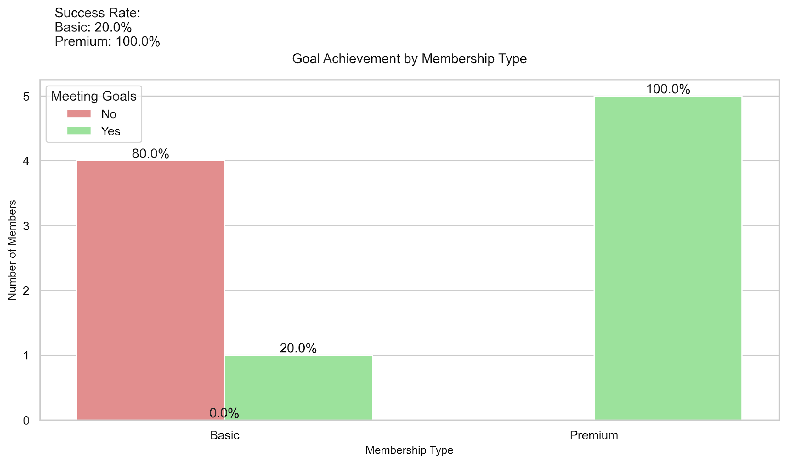
Challenge: Data Detectives

Slide 65
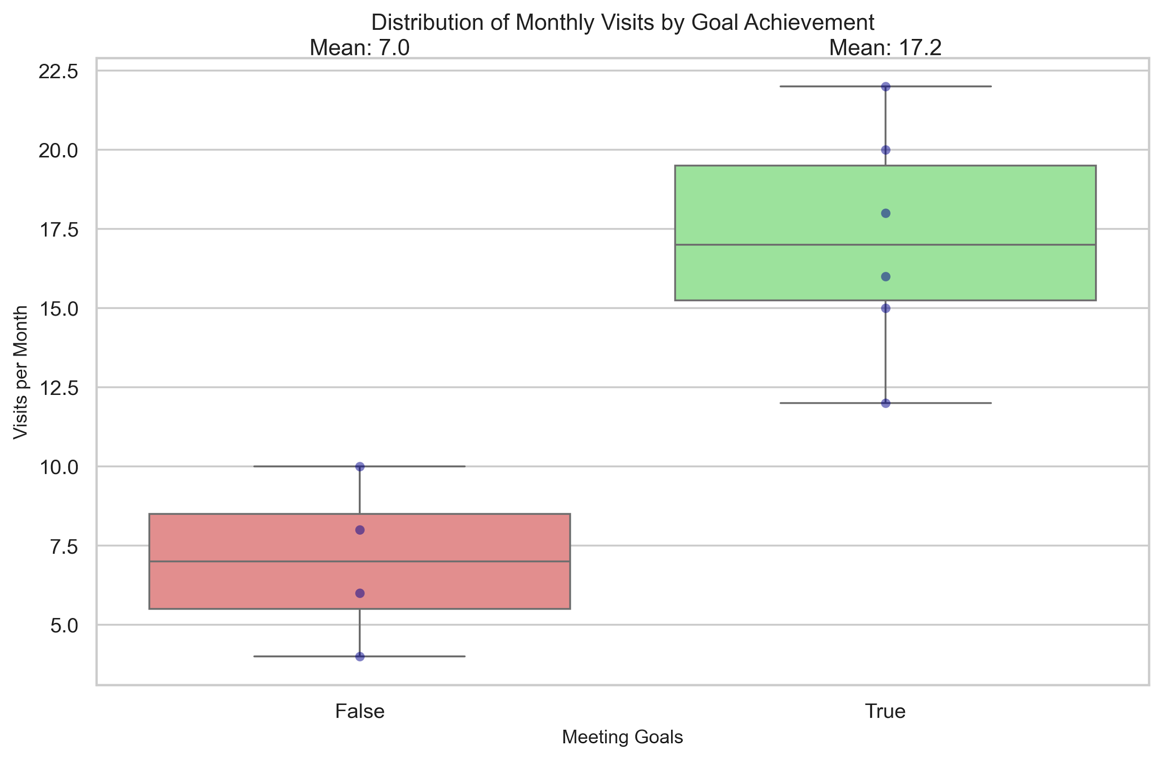
Challenge: Data Detectives

Slide 66
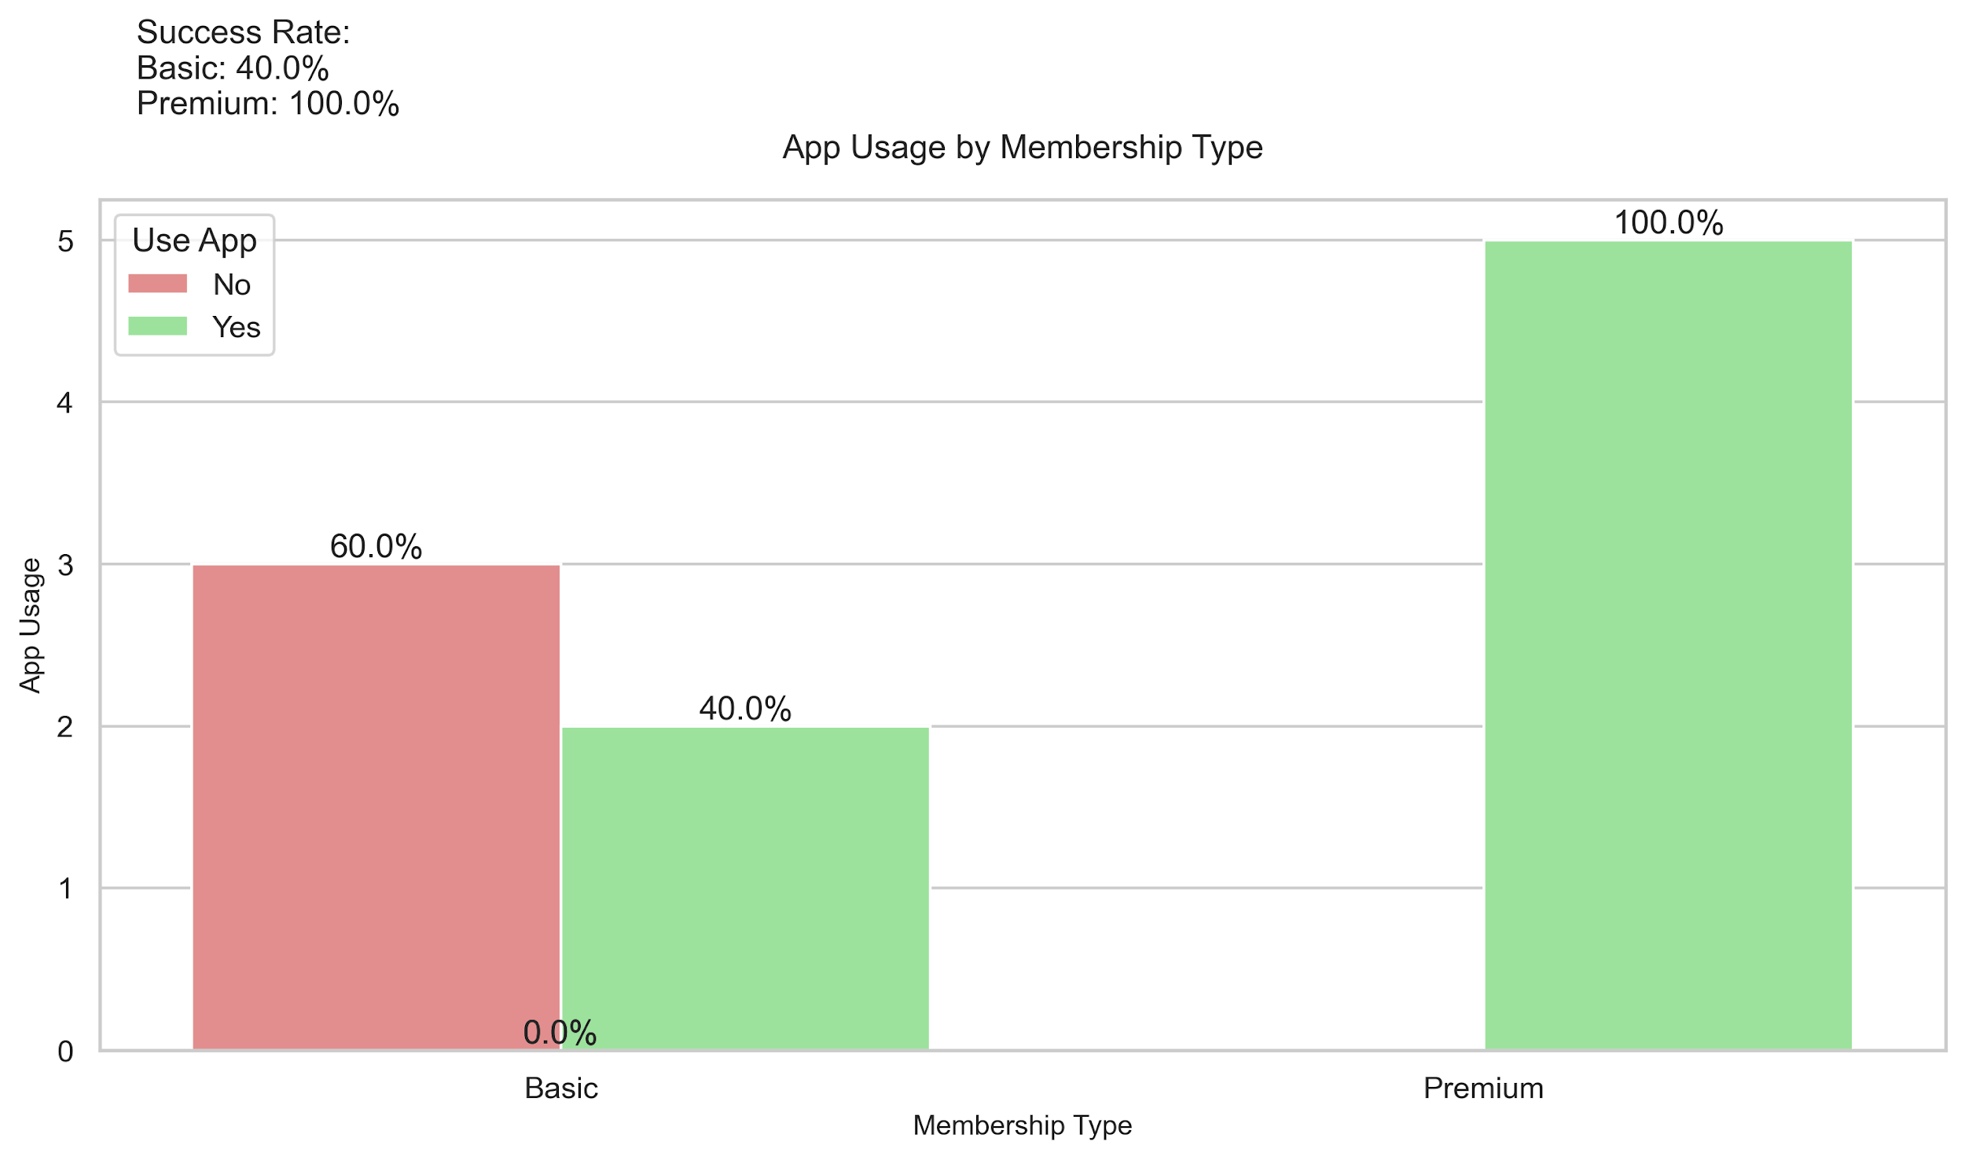
Challenge: Data Detectives

Slide 67
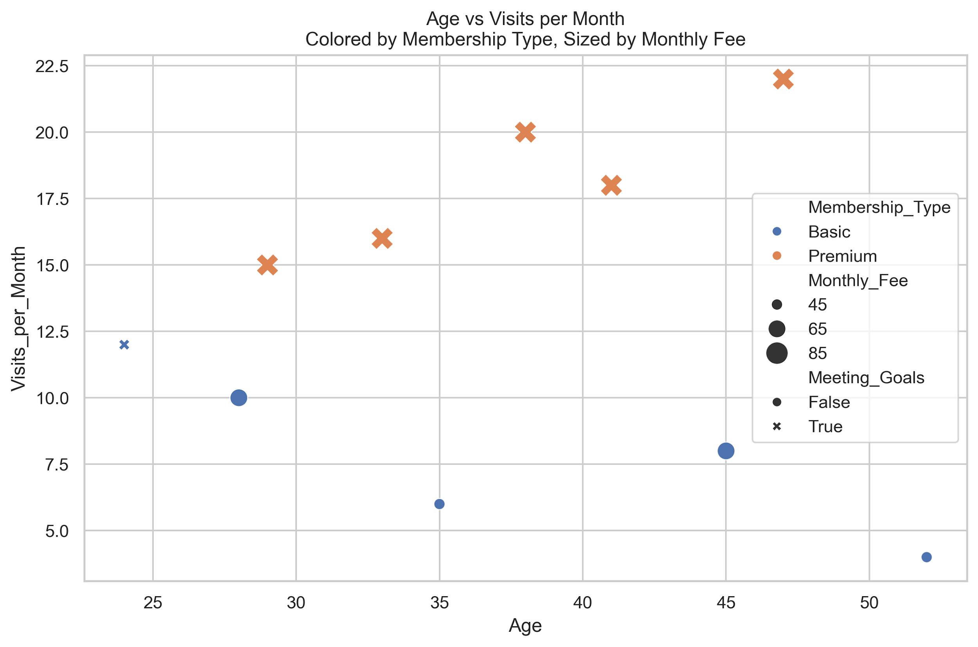
Challenge: Data Detectives

Slide 68
Questions?

